Slide 1
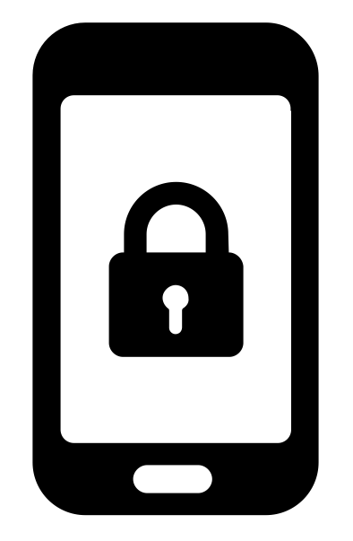


Libraries for privacy
private by Gregor Cresnar
from the Noun Project
Training for staff
Created by Aude Charillon for Newcastle Libraries in March 2017
Published under a Creative Commons Attribution licence (CC BY)
Training inspired by the Libraries for privacy workshop delivered by Nik Williams (Scottish PEN) in Edinburgh January 2017.
Notes:
What is privacy? Why am talking to you about it?
How does it fit with the role of librarians?

Slide 2

Notes:
Some answers:
Protecting intellectual freedoms: freedom of information & freedom of expression
Universal Declaration of Human Rights article 12: “No one shall be subjected to arbitrary interference with his privacy, family, home or correspondance, nor to attacks upon his honour and reputation. Everyone has the right to the protection of the law against such interference or attacks.”
Digital skills
[Pixabay free photo under CC0]

Slide 3
“Librarians have the understanding and expertise to
champion and promote openness and the public’s right to information;
oppose censorship and efforts to inhibit access to information;
select and make available information;
guide and support the public to seek, obtain and navigate
available information;
support the public to utilise and share this information;
facilitate intellectual and cultural creativity;
and safeguard the privacy of the public through ensuring data collation and surveillance are necessary, proportionate and lawful.”
Ambition & opportunity: a strategy for public libraries in Scotland 2015-2020. Strategic aim 5: Libraries promoting culture and creativity
Notes:
Meanwhile in Scotland…

Slide 4
How do you protect your privacy online
anyway?
Notes:
Think about it with threat modelling
Then do something with tips and tools

Slide 5
Threat modelling
What information / data do you want to protect?
Who do you want to protect it from?
How likely is it that you will need to protect it?
How bad are the consequences if you fail?
How much trouble are you willing to go through in order to try to prevent those?
Notes:
Exercise for participants: with the person(s) sitting next to you, go through the questions as applied to you as an individual. (no more than 10min) (or if done individually: 5min)
Share /discuss some of your answers with the wider group (no more than 5-10min)

Slide 6

Notes:
Some tips and tools to protect your privacy online
[Pixabay free photo under CC0]

Slide 7
Passphrases
rather than passwords
The longer the passphrase the more difficult for a computer to crack it.
Words are easier for us humans to remember.
Make it random (for example using diceware).
Notes:
(No more than 5min)

Slide 8
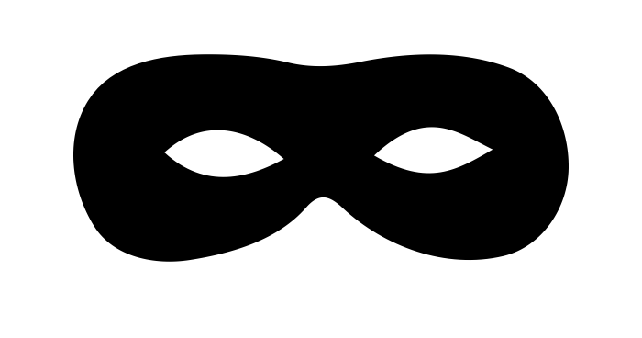
Big Browser is watching you!
“Incognito” modes
Browser add-ons
Search engines
Tor Browser
mask by Sergey Patutin
from the Noun Project
Notes:
Browser add-ons: Privacy Badger
Search engines: DuckDuckGo, Qwant
Show Chrome Incognito mode, Privacy Badger, search engines and Tor Browser on laptop
Tor Browser CryptoParty Newcastle handout
(No more than 10min)

Slide 9
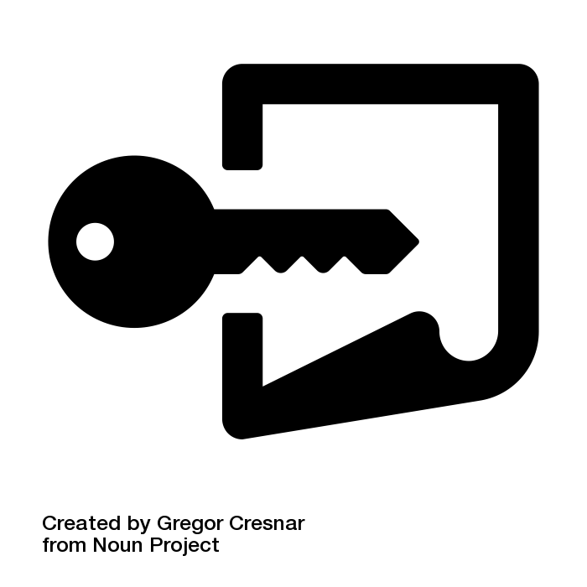
Secure communications
HTTPS
Email encryption
Messaging services
Notes:
HTTPS Everywhere browser add-on
Email: mention PGP and Protonmail
Messaging: Signal – CryptoParty Newcastle handout
(No more than 5min)

Slide 10
What could we do in libraries
to help our users?
Notes:
Chat (10-15min)
Write down actions / propositions and share with group afterwards to confirm what has been discussed / agreed

Slide 11
If you only visited 3 websites
about privacy…
How to encrypt your entire life in less than an hour by Quincy Larson (9 November 2016);
Library Freedom Project resources;
CryptoParty Newcastle discussion forum of the Open Rights Group North East members and other privacy-minded individuals.
Notes:
Further reading

